Slide 1
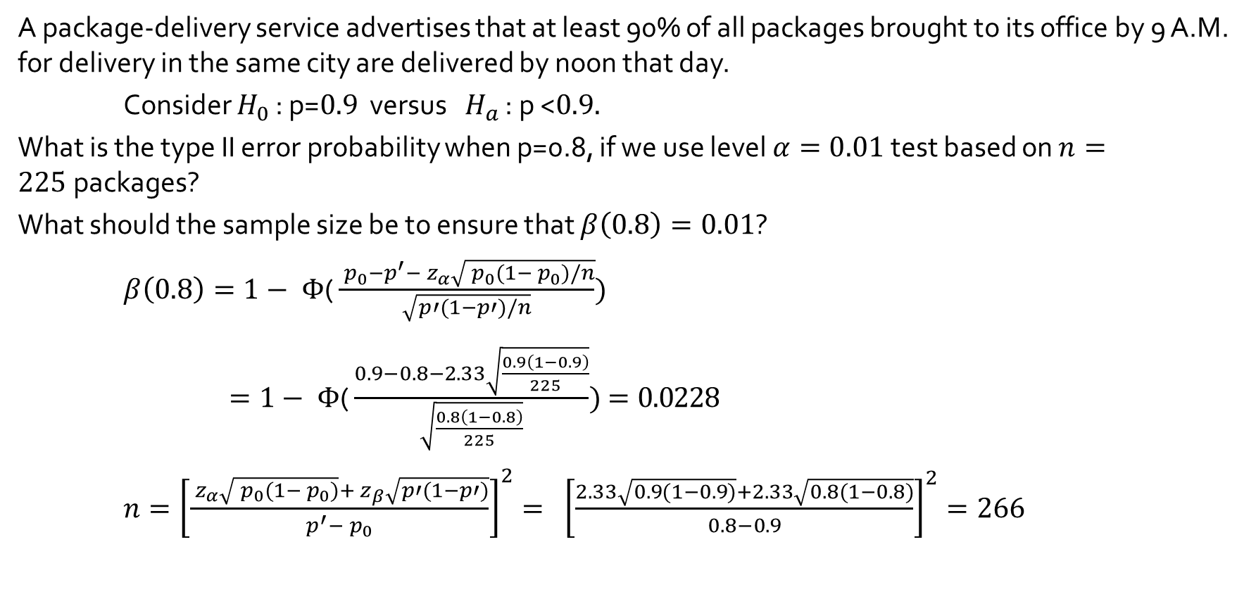
Example 8.12 : Computation of $β$
A package-delivery service advertises that at least 90% of all packages brought to its office by 9 A.M. for delivery in the same city are delivered by noon that day.
Consider $H_{0}$ : p=$0.9$ versus $H_{a}$ : p <$0.9.$
What is the type II error probability when p=0.8, if we use level $α=0.01$test based on $n=225$packages?
What should the sample size be to ensure that $β\left(0.8\right)=0.01$?
$β\left(0.8\right)=1− Φ\text{(}\frac{{ p}_{0}−p^{′}−{ z}_{α}\sqrt{{ p}_{0}(1−{ p}_{0})/n}}{\sqrt{p′(1−p′)/n}})$
$=1− Φ\text{(}\frac{0.9−0.8−2.33\sqrt{\frac{0.9\left(1−0.9\right)}{225}}}{\sqrt{\frac{0.8\left(1−0.8\right)}{225}}})=0.0228$
$n={\left[\frac{{ z}_{α}\sqrt{{ p}_{0}(1−{ p}_{0})}+{ z}_{β}\sqrt{p′(1−p′)}}{p^{′}−{ p}_{0}}\right]}^{2}=$ ${\left[\frac{2.33\sqrt{0.9(1−0.9)}+2.33\sqrt{0.8(1−0.8)}}{0.8−0.9}\right]}^{2}=266$

Slide 2
β(p’) Summary

Slide 3

Example 8.12 - another solution
Rejection region :
$Z=\frac{\hat{p}−{ p}_{0}}{\sqrt{{ p}_{0}(1−{ p}_{0})/n}}=\frac{\hat{p}−0.9}{\sqrt{0.9(1−0.9)/225}}<{ −z}_{α}=−{ z}_{0.01}=−2.33$
$\hat{p}\text{ <}0.9 \text{− }2.33\sqrt{0.9(1−0.9)/225}=0.8534$
$β\left(0.8\right)=P\left(\hat{p}>0.8534 when p=0.8\right)$
$=P\text{(}\frac{\hat{p}−0.8}{\sqrt{0.8(1−0.8)/225}}\text{>}\frac{0.8534−0.8}{\sqrt{0.8(1−0.8)/225}})$
$=P\text{(}Z\text{>}2.0025)=0.0226$

Slide 4
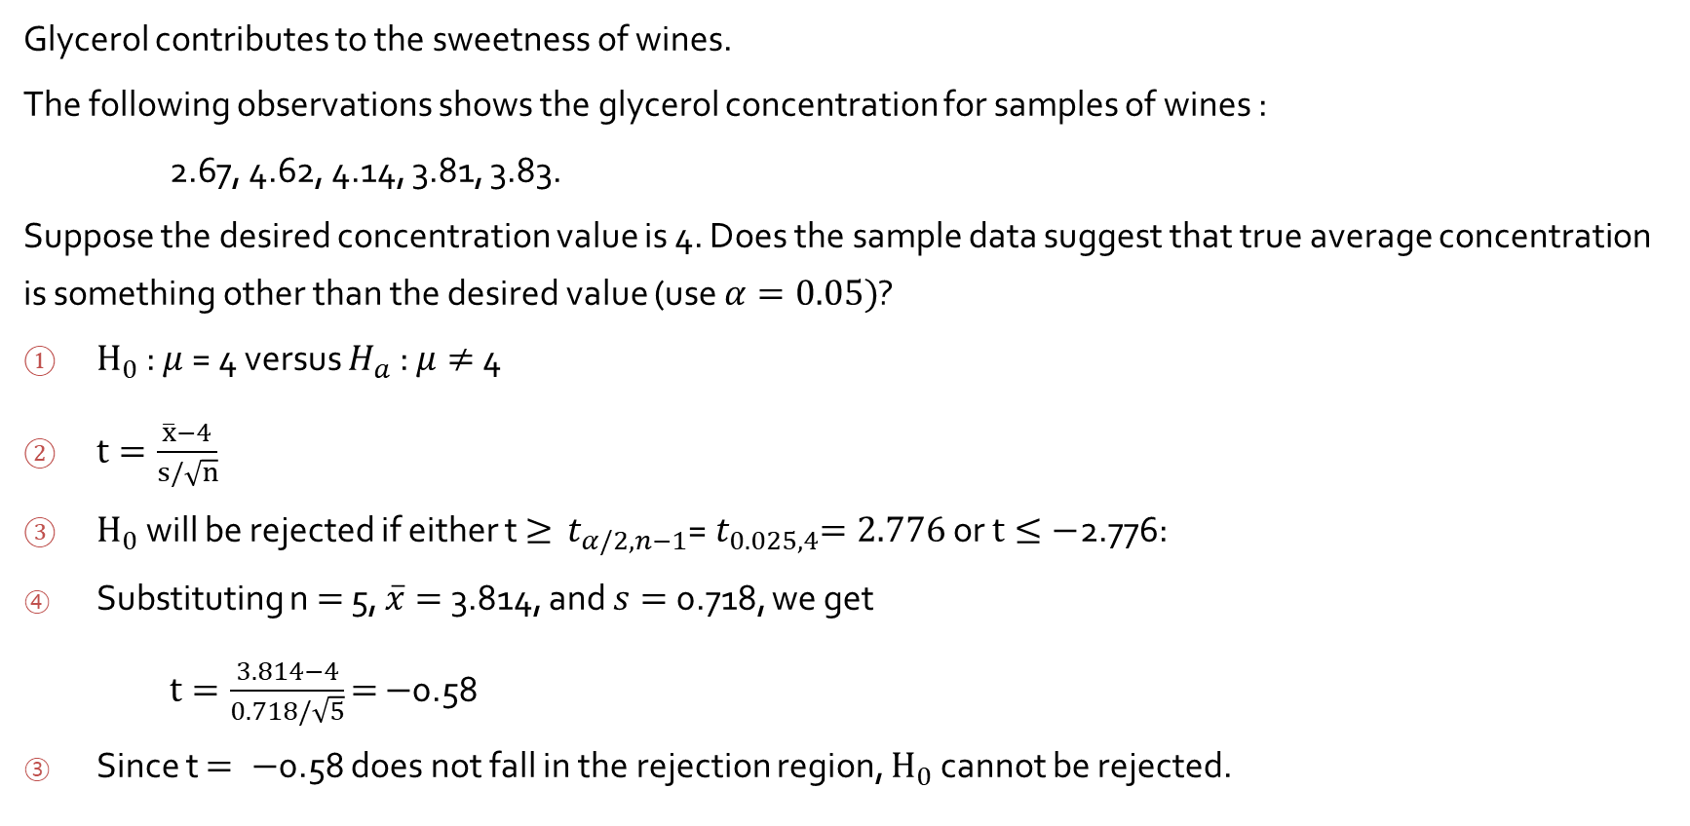
Example 8.9
Glycerol contributes to the sweetness of wines.
The following observations shows the glycerol concentration for samples of wines :
2.67, 4.62, 4.14, 3.81, 3.83.
Suppose the desired concentration value is 4. Does the sample data suggest that true average concentration is something other than the desired value (use $α=0.05)$?
$H_{0}$ : $μ$= 4 versus $H_{a}$ : $μ≠$4
$t=\frac{\overline{x}−4}{s/\sqrt{n}}$
$H_{0}$ will be rejected if either t $≥$ ${ t}_{α/2, n−1}$=${ t}_{0.025,4}=2.776$ or $t≤−$2.776:
Substituting n $=$ 5, $\overline{x}=$ 3.814, and $s=$ 0.718, we get
$t=\frac{3.814−4}{0.718/\sqrt{5}}$ $=$ $−$0.58
Since t $= −$0.58 does not fall in the rejection region, $H_{0}$ cannot be rejected.

Slide 5
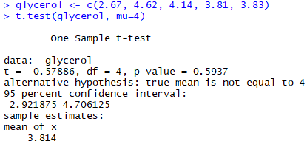
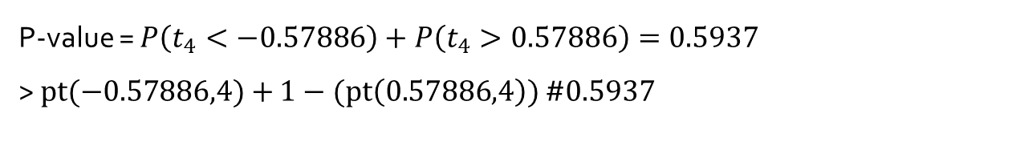
P-value = $P\left(t_{4}<−0.57886\right)+P\left(t_{4}>0.57886\right)=0.5937$
> $pt(−0.57886,4)+$ $1−(pt\left(0.57886,4\right))$ #$0.5937$

Slide 6

P-Values for t distribution
$T=\frac{\overline{X}−{ μ}_{0}}{s/\sqrt{n}}\sim$ $t_{n−1}$
$H_{0}$ : $μ$ = $μ_{0}$
P-value
$H_{a}$ : $μ$ > $μ_{0}$ $P(t_{n−1}>t \text{when} μ \text{=}μ_{0})$ $t :$the value calculated from the available sample
${ H}_{a}$ : $μ$ < $μ_{0}$ $P(t_{n−1}<t \text{when} μ \text{=}μ_{0})$
$H_{a}$ : $μ { ≠μ}_{0}$ $P\left(t_{n−1}<−\left|t\right| \text{when} μ \text{=}μ_{0}\right)+P\left(t_{n−1}>\left|t\right| \text{when} μ \text{=}μ_{0}\right)$

Slide 7
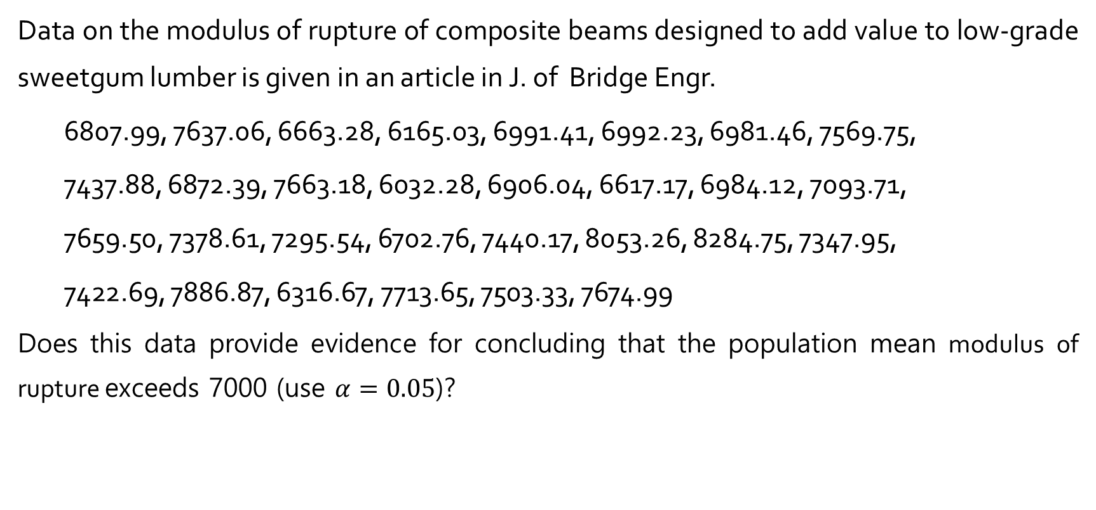
Hypothesis Test of mean
Data on the modulus of rupture of composite beams designed to add value to low-grade sweetgum lumber is given in an article in J. of Bridge Engr.
6807.99, 7637.06, 6663.28, 6165.03, 6991.41, 6992.23, 6981.46, 7569.75,
7437.88, 6872.39, 7663.18, 6032.28, 6906.04, 6617.17, 6984.12, 7093.71,
7659.50, 7378.61, 7295.54, 6702.76, 7440.17, 8053.26, 8284.75, 7347.95,
7422.69, 7886.87, 6316.67, 7713.65, 7503.33, 7674.99
Does this data provide evidence for concluding that the population mean modulus of rupture exceeds 7000 (use $α=0.05$)?

Slide 8
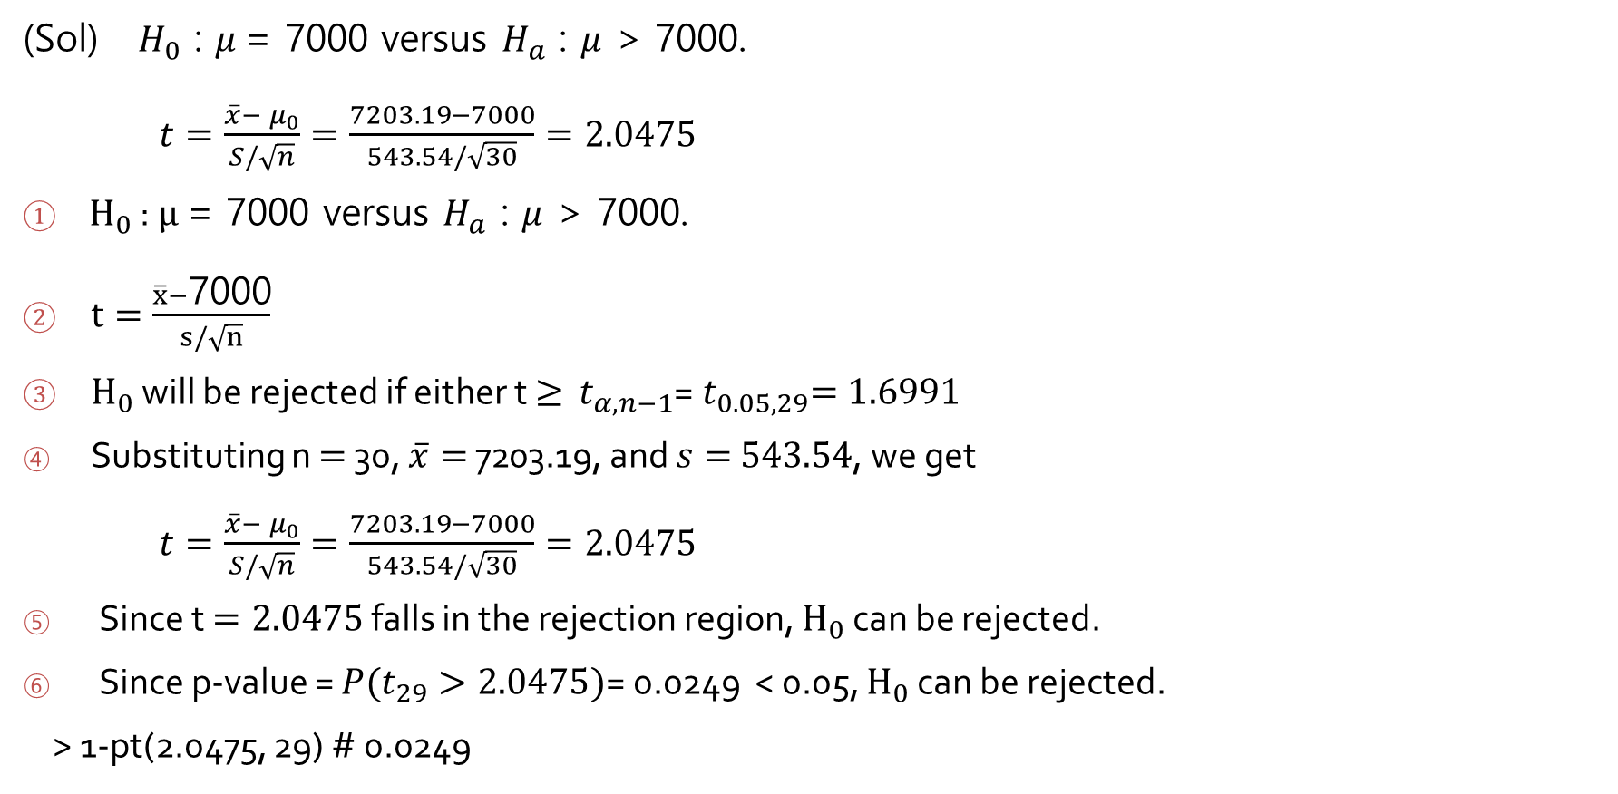
(Sol) $H_{0}$ : $μ$= 7000 versus $H_{a}$ : $μ$ > 7000.
$t=\frac{\overline{x}−{ μ}_{0}}{S/\sqrt{n}}=\frac{7203.19−7000}{543.54/\sqrt{30}}=2.0475$
$H_{0}$ : $μ$= 7000 versus $H_{a}$ : $μ$ > 7000.
$t=\frac{\overline{x}−\text{7}\text{000}}{s/\sqrt{n}}$
$H_{0}$ will be rejected if either t $≥$ ${ t}_{α, n−1}$=${ t}_{0.05,29}=1.6991$
Substituting n $=$ 30, $\overline{x}=$ 7203.19, and $s=$ $543.54$, we get
$t=\frac{\overline{x}−{ μ}_{0}}{S/\sqrt{n}}=\frac{7203.19−7000}{543.54/\sqrt{30}}=2.0475$
Since t $=2.0475$ falls in the rejection region, $H_{0}$ can be rejected.
Since p-value = $P(t_{29}>2.0475)$= 0.0249 < 0.05, $H_{0}$ can be rejected.
> 1-pt(2.0475, 29) # 0.0249

Slide 9
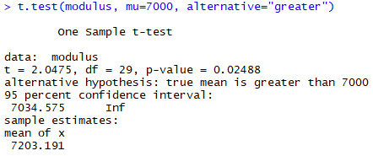
modulus <- c(6807.99, 7637.06, 6663.28, 6165.03, 6991.41, 6992.23, 6981.46, 7569.75, 7437.88, 6872.39, 7663.18, 6032.28, 6906.04, 6617.17, 6984.12, 7093.71, 7659.50, 7378.61, 7295.54, 6702.76, 7440.17, 8053.26, 8284.75, 7347.95, 7422.69, 7886.87, 6316.67, 7713.65, 7503.33, 7674.99)

